Slide 1
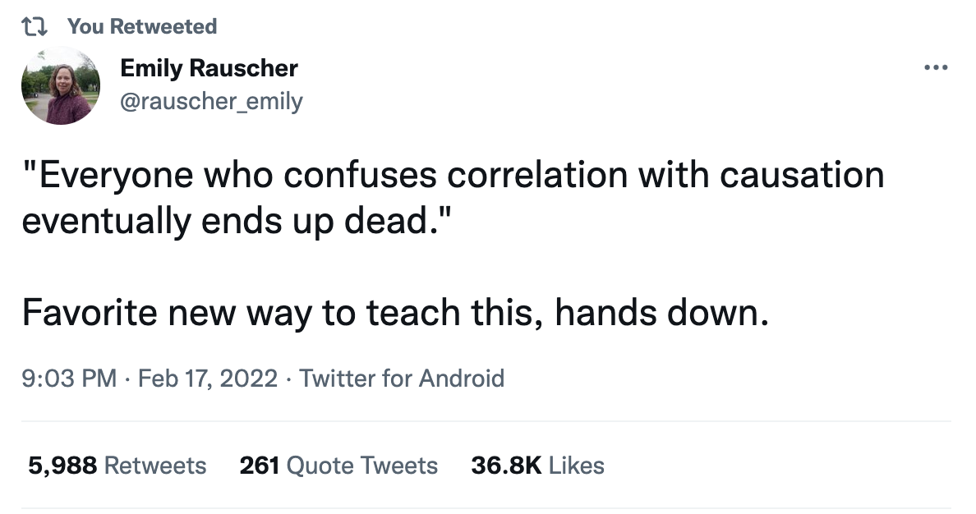
Correlation versus Causation

Slide 2
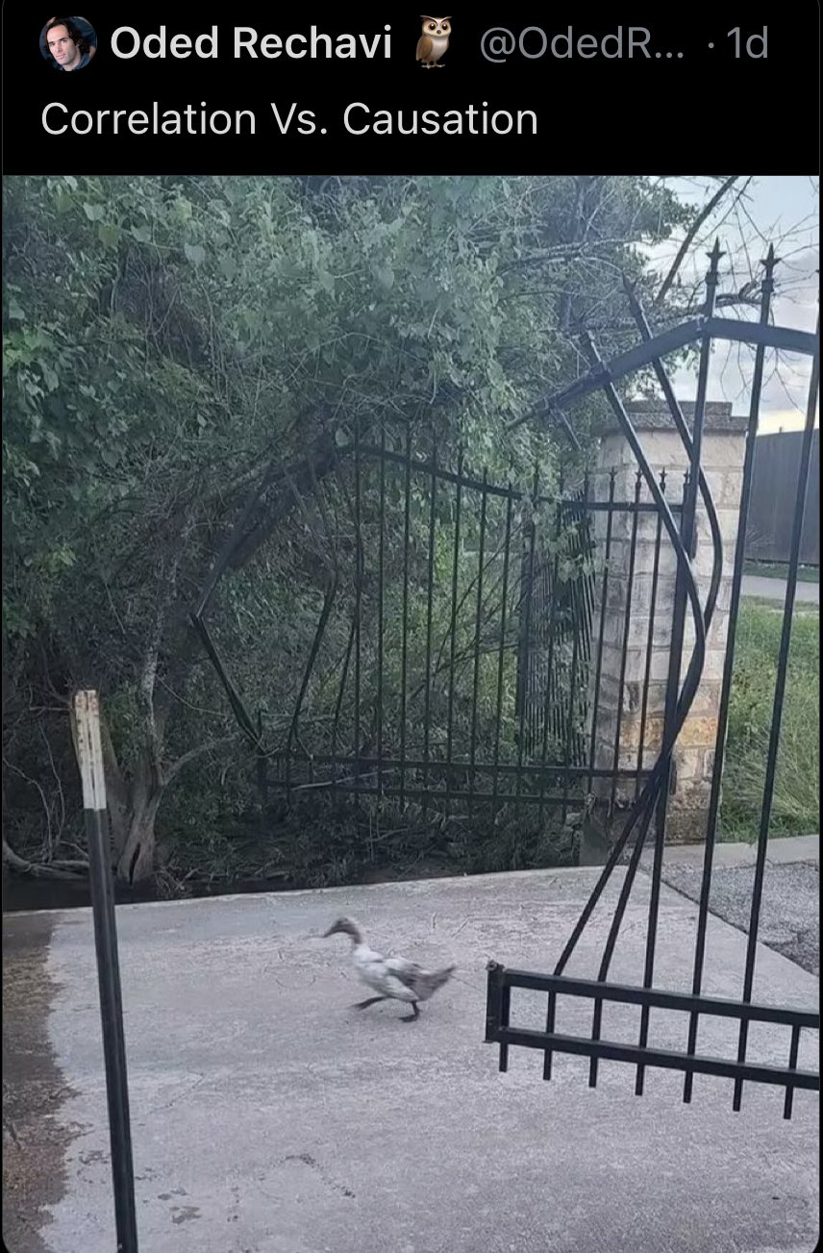

Slide 3
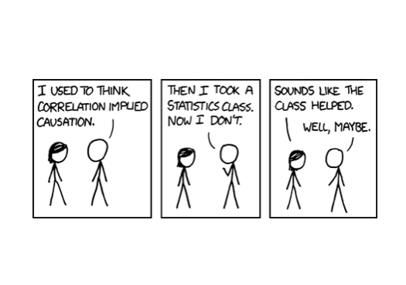

Slide 4
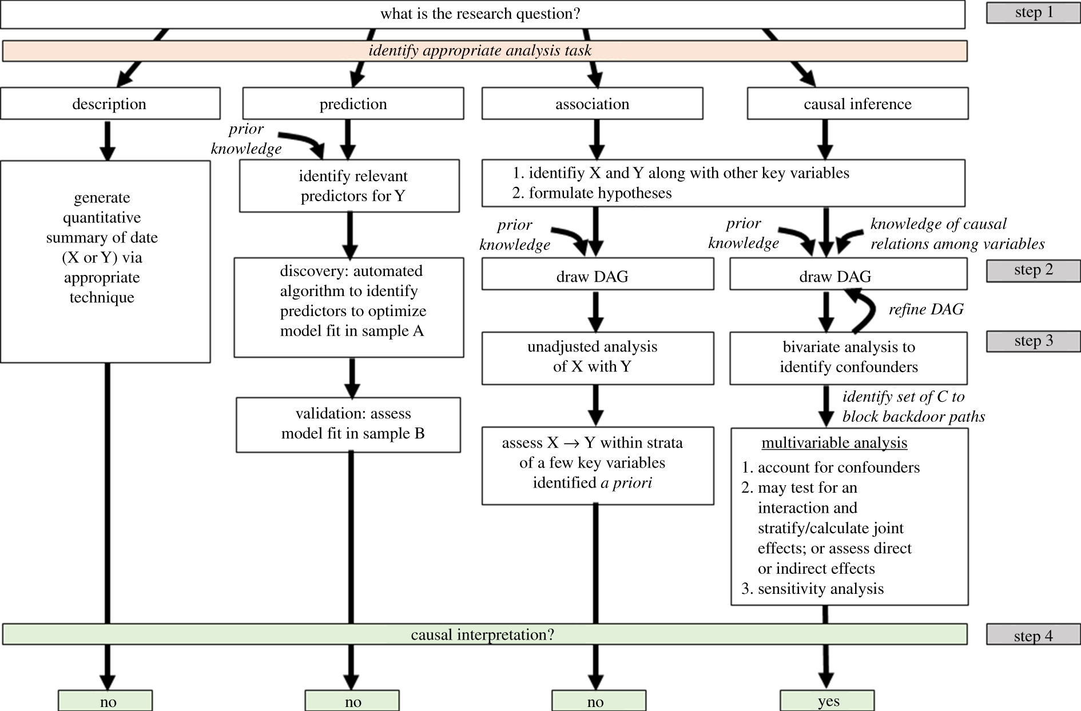
Causal Inference
Laubach ZM, Murray EJ, Hoke KL, Safran RJ, Perng W. 2021 A biologist’s guide to model selection and causal inference. Proc. R. Soc. B 288: 20202815. https://doi.org/10.1098/rspb.2020.2815
Notes:
Data analysis tasks and modelling approaches.

Slide 5
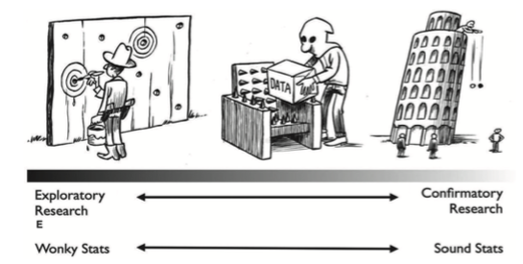
Avoiding false-positive findings
Dirk-Jan Hoek

Slide 6
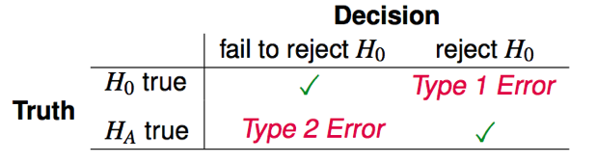
Type 1 Errors (False Positives) and Type 2 Errors (False Negatives)

Slide 7
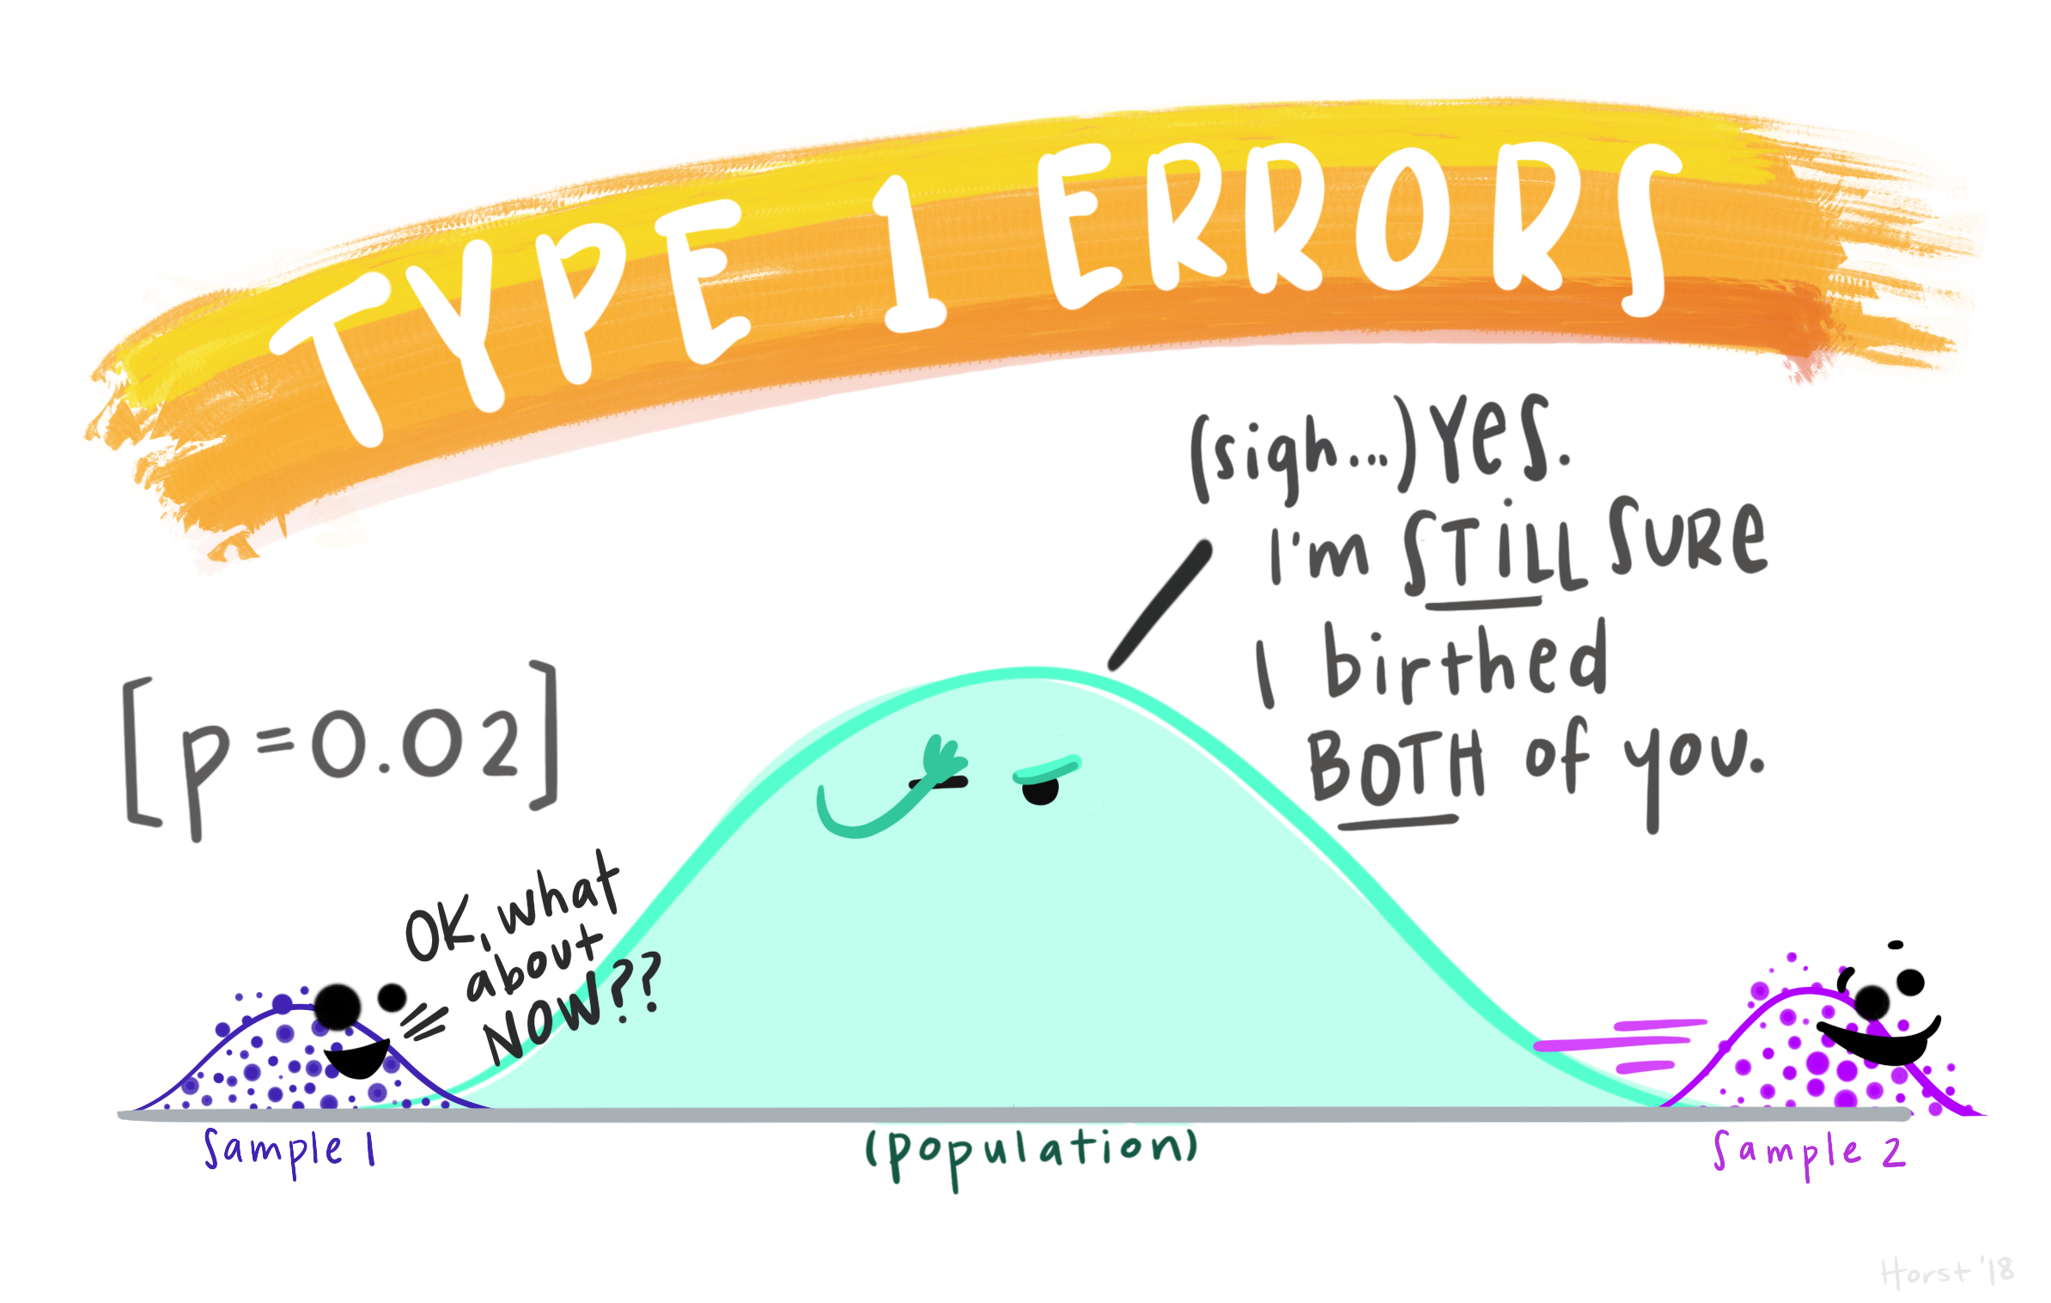
Artwork by @allison_horst

Slide 8
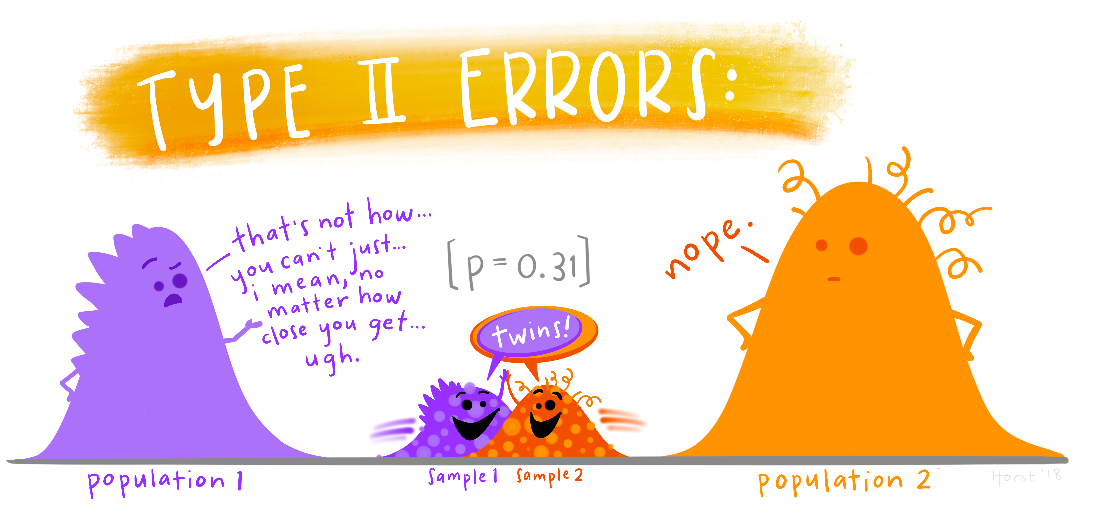
Artwork by @allison_horst

Slide 9
Why Most Published Research Findings Are False
Ioannidis JP. “Why most published research findings are false”, PLoS Medicine 2005 Aug 30;2(8):e124.
Ulrich Schimmack, “Ioannidis is Wrong Most of the Time”, R-Index blog, https://replicationindex.com/2020/12/24/ioannidis-is-wrong/
Ioannidis JP. “A fiasco in the making? As the coronavirus pandemic takes hold, we are making decisions without reliable data”, STAT News, March 17, 2020
Ulrich Schimmack, “Ioannidis is Wrong Again”, R-Index blog, https://replicationindex.com/2020/12/26/ioannidis-is-wrong-again/
David Gorski, “What the heck happened to John Ioannidis?”, Science Based Medicine blog, March 29, 2021

Slide 10
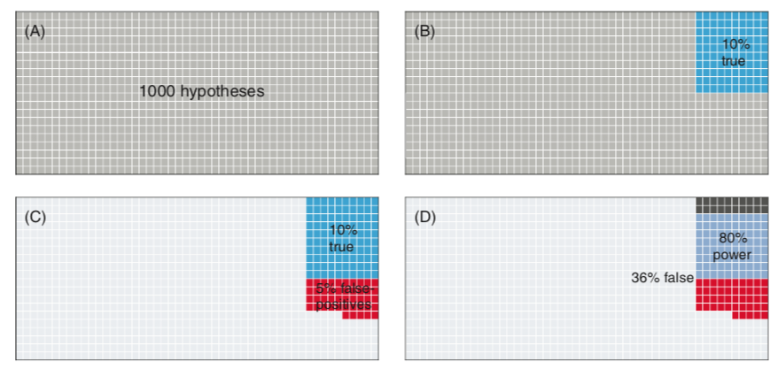
One thousand hypotheses
Type II Errors
α = 0.05
False positive report probability = 45/(45+80) = 36%
Type I Errors

Slide 11
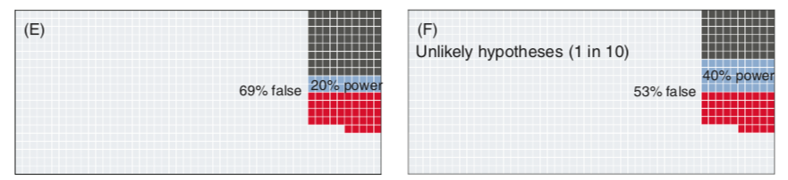
It gets worse
Study with low statistical power
Study with moderate statistical power
False positive report probability = 69%
False positive report probability = 53%

Slide 12
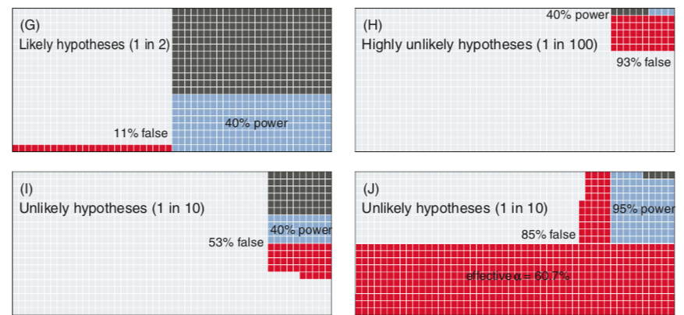
11%
93%
Researcher degrees of freedom

Slide 13
Proportion of false-positive reports (out of all positive reports) will be highest for:
Fields with mostly underpowered studies
Fields with unlikely hypotheses (driven by pursuit of novelty)
Fields that poorly guard against raising the level of α (significance seeking)
Forstmeier W, Wagenmakers EJ, Parker TH. Detecting and avoiding likely false‐positive findings–a practical guide. Biological Reviews. 2017 Nov;92(4):1941-68.

